Slide 1

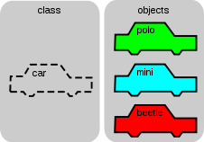
HOW HAS OOAD HELPED?
Object-Orientation has enabled us to create 4 types of modules and create many classes within those modules. Each class consists of many instances of classes(objects) that interact dynamically to create our inventive application RandomConnect!

Slide 2

RandomConnect
Group-10
KHUSBOO SOLANKI
RAMA GUPTA
SHUBHAM GOYAL
KARTHIKEY GARG
POOJA RAO

Slide 3

THE 4 MODULES INCLUDE:-
)ALGORITHMIC THINKING MODULE
)CHAT MODULE
)GAME MODULE
)SECURITY MODULE

Slide 4

ALGORITHMIC THINKING
ALGORITHMIC THINKING
RandomConnect is an application that is based on a randomized algorithm that connects people to new people
A new user needs to log in and enter his/her interests, hobbies and likes/dislikes in order to find the right people.

Slide 5
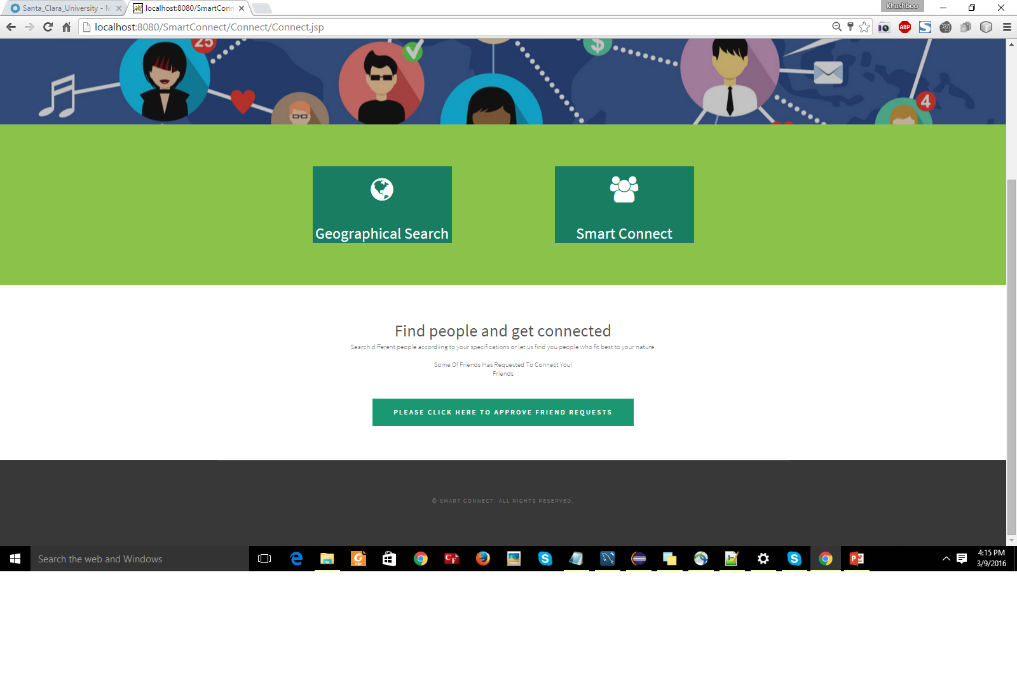

ALGORITHMIC THINKING
ALGORITHMIC THINKING

Slide 6
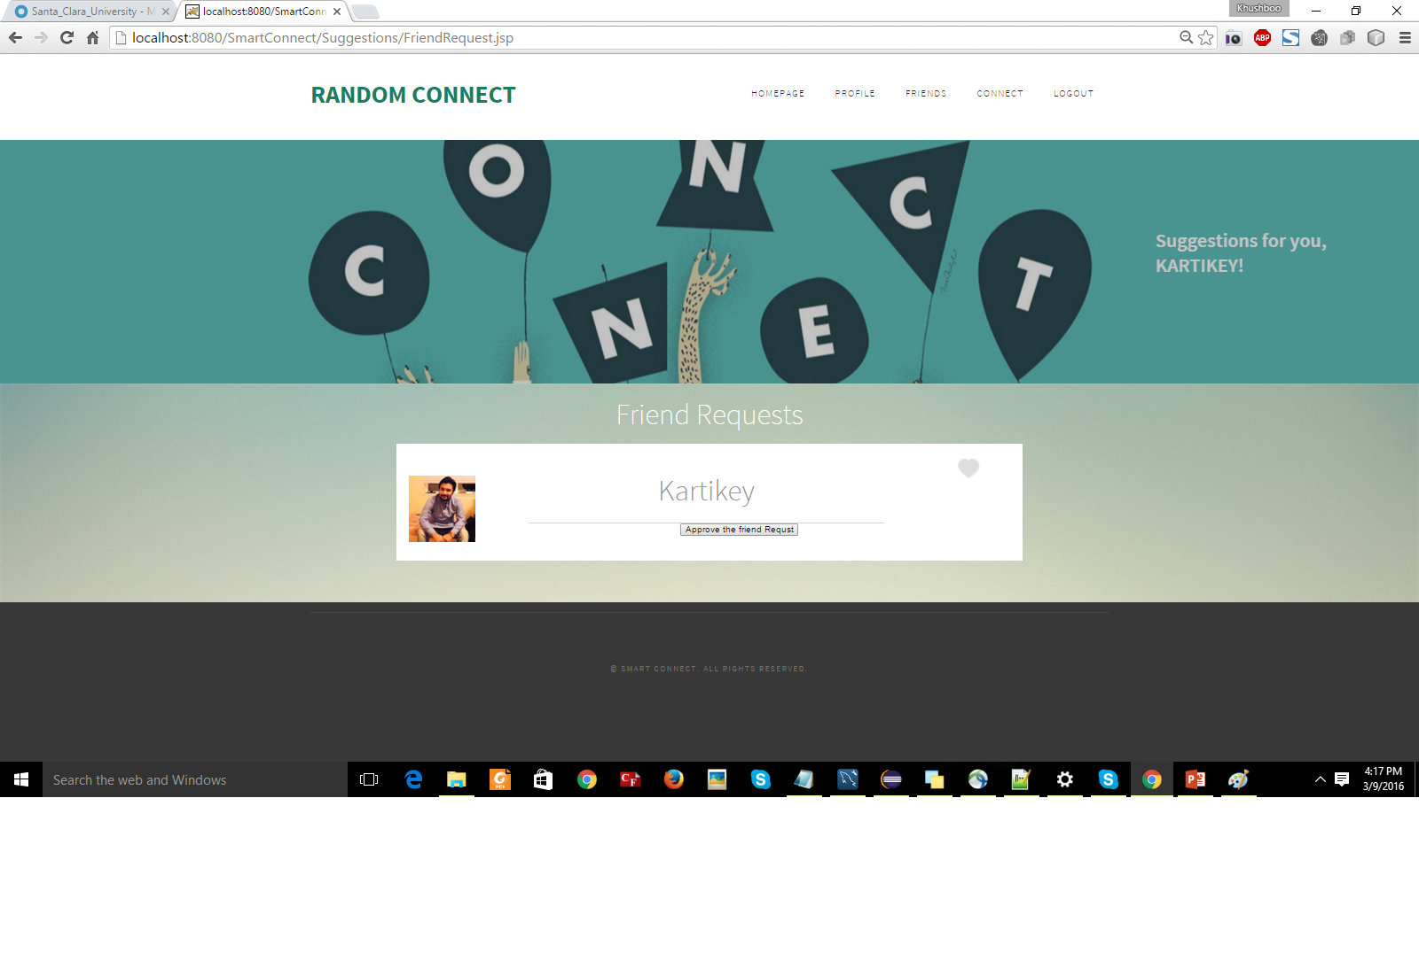
ALGORITHMIC THINKING
ALGORITHMIC THINKING

Slide 7
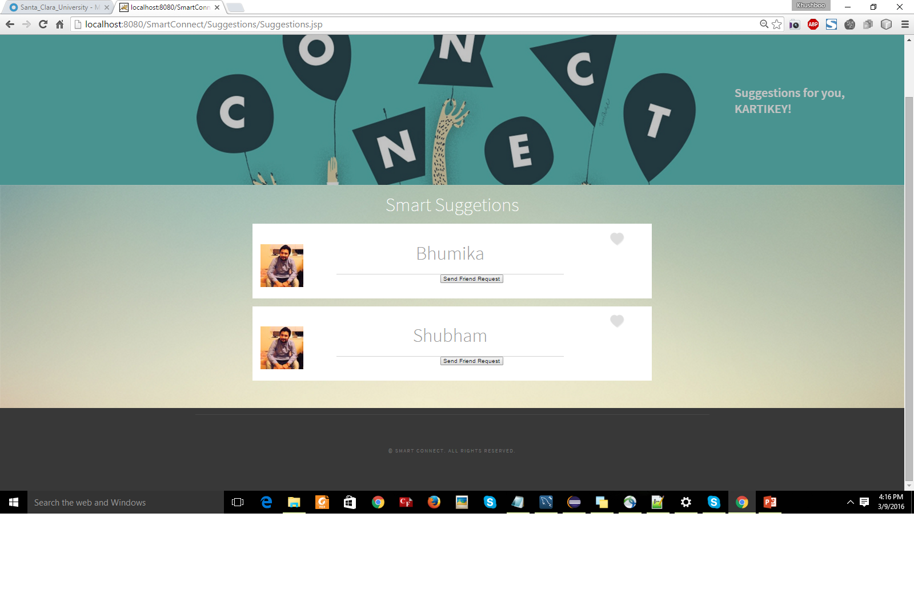
ALGORITHMIC THINKING
ALGORITHMIC THINKING

Slide 8
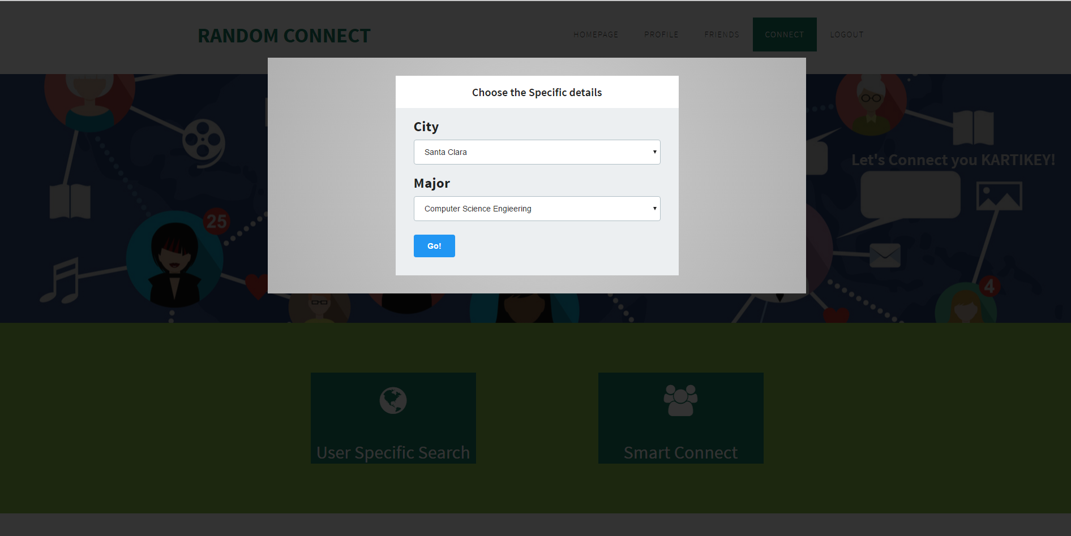
ALGORITHMIC THINKING
ALGORITHMIC THINKING

Slide 9
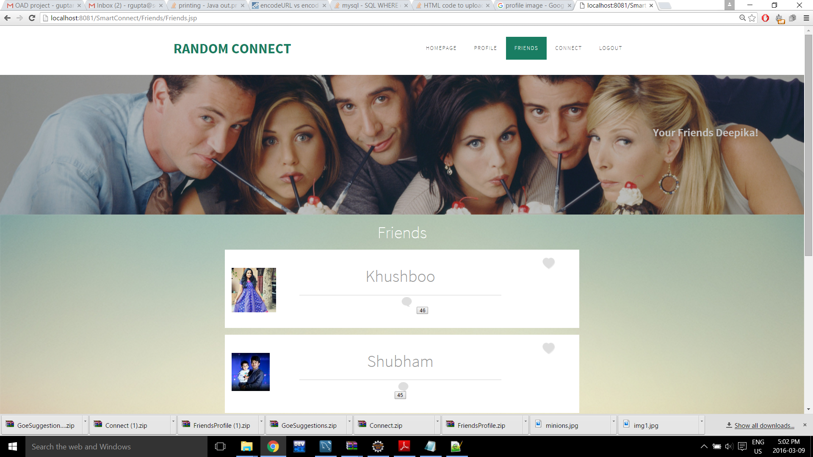

Slide 10
ALGORITHMIC THINKING
These ratings include:- Honestlylevel , respectlevel , loyaltylevel , integritylevel , responsibilitylevel , carelevel , fairnesslevel , hobbies1 and hobbies2.
Based on the ratings of these we calculate the average and send 5 matches to the newly registered student.
RATING:6
New Student 1
RATING:6
New Student 2
RATING:6
New Student 3
RATING:6
New Student 4
RATING:6
New Student 5
REGISTERED STUDENT :Rating 6

Slide 11
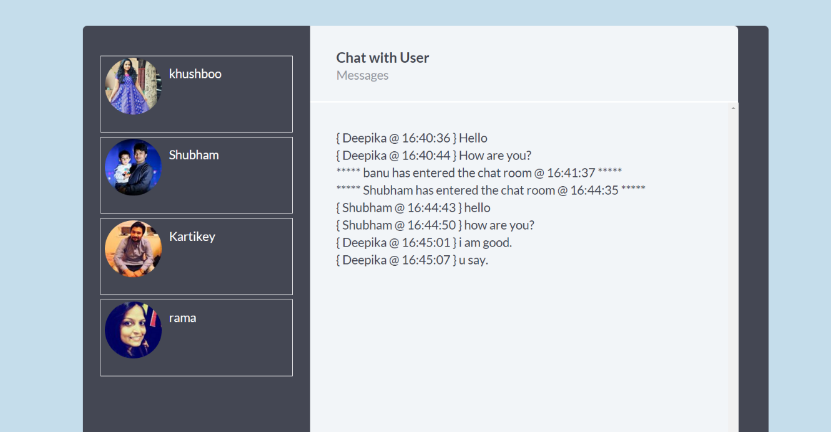
CHATTING
This Module has been created for a newly registered Student to
Chat with 1-4 other new students in order to enhance their College
Experience.
THE TYPES OF CHAT ACTIVITIES OUR APPLICATION IS OFFERING:-
ONE-ON-FIVE CHAT
GROUP CHAT

Slide 12

THE GAME
We are implementing the flappy bird game for the registered student to play with the other students in order to interactive and have fun with each other’s company. We have it using melon.js.

Slide 13
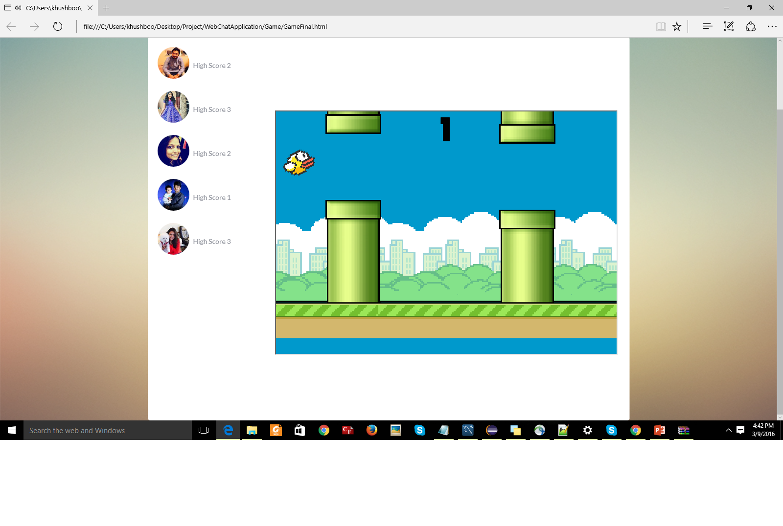
THE GAME

Slide 14
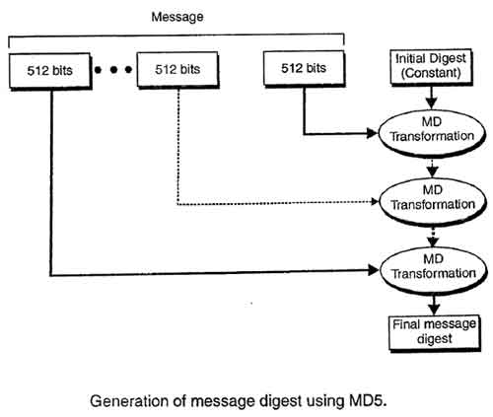
SECURITY MODULE
The SECURITY MODULE CONSISTS OF THE MD5 CHECKSUM ALGORITHM THAT WE HAVE IMPLEMENTED IN OUR LOGIN AND REGISTRATION PAGES.
The MD5 message-digest algorithm is a widely used cryptographic hash function producing a 128-bit hash value.

Slide 15
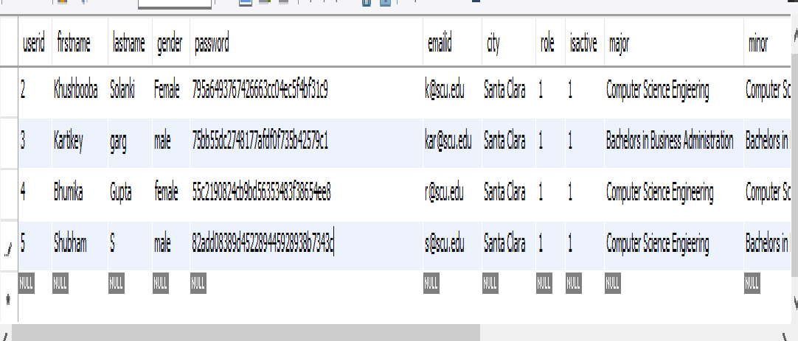
SECURITY MODULE

Slide 16
USE CASE DIAGRAM
Register
Enter Username
Register
«
»
include
«
include
»
login
Enter Password
Logout
user
Admin
Profile
«
include
»
«
include
Edit Profile
»
View profile

Slide 17
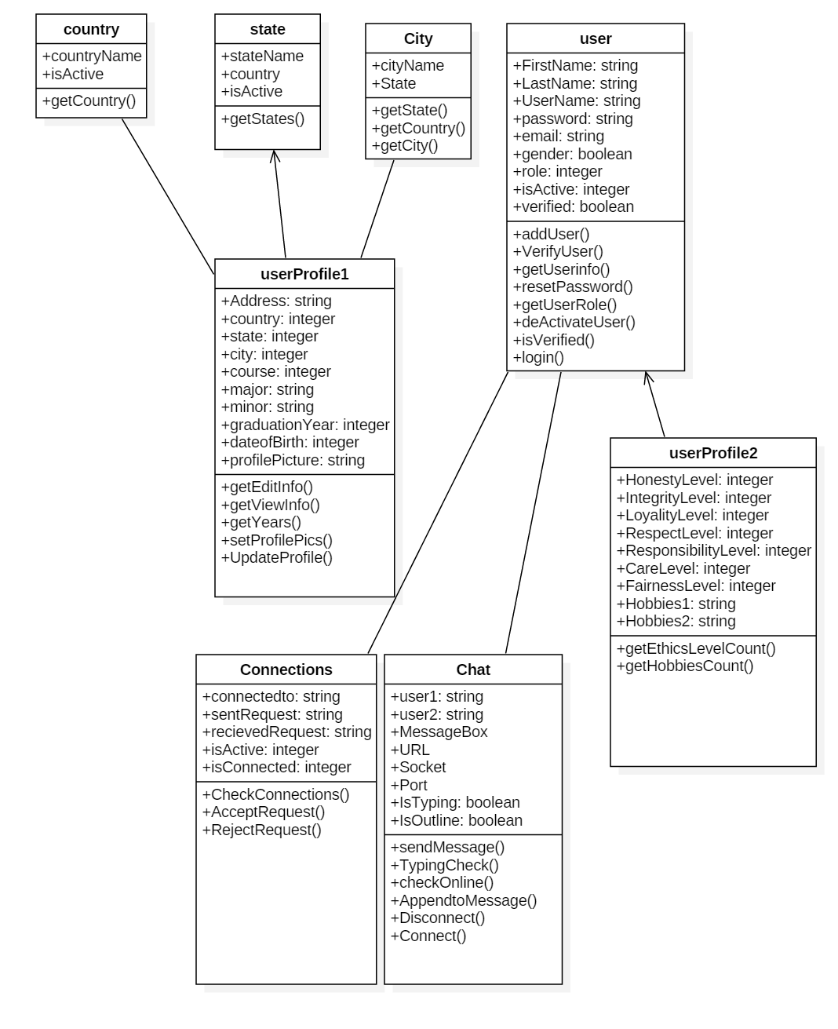
THE CLASS DIAGRAM

Slide 18
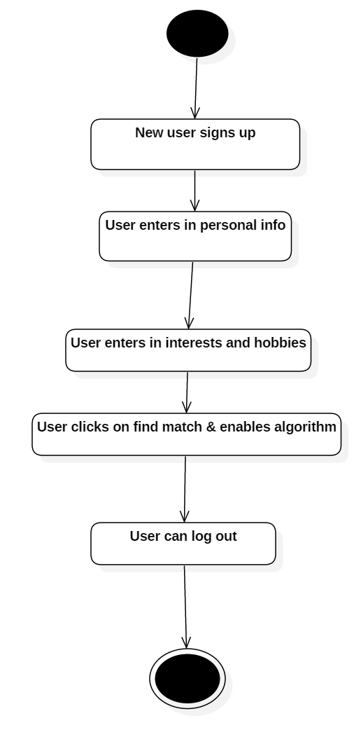
THE ACTIVITY DIAGRAM

Slide 19
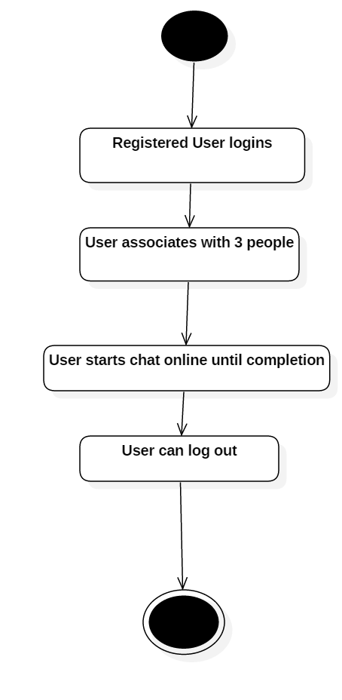
THE ACTIVITY DIAGRAM

Slide 20
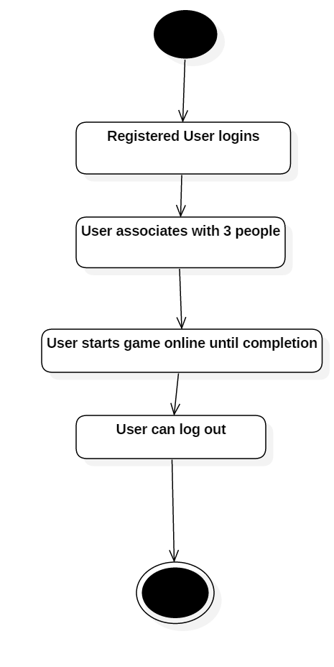
THE ACTIVITY DIAGRAM

Slide 21
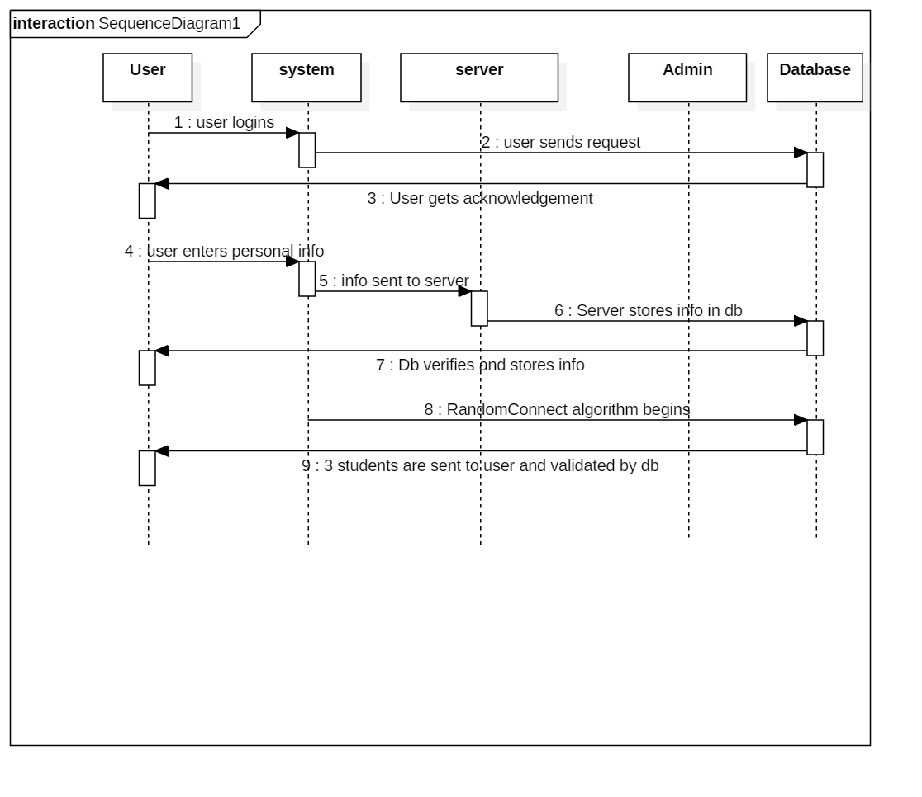
THE SEQUENCE DIAGRAM

Slide 22
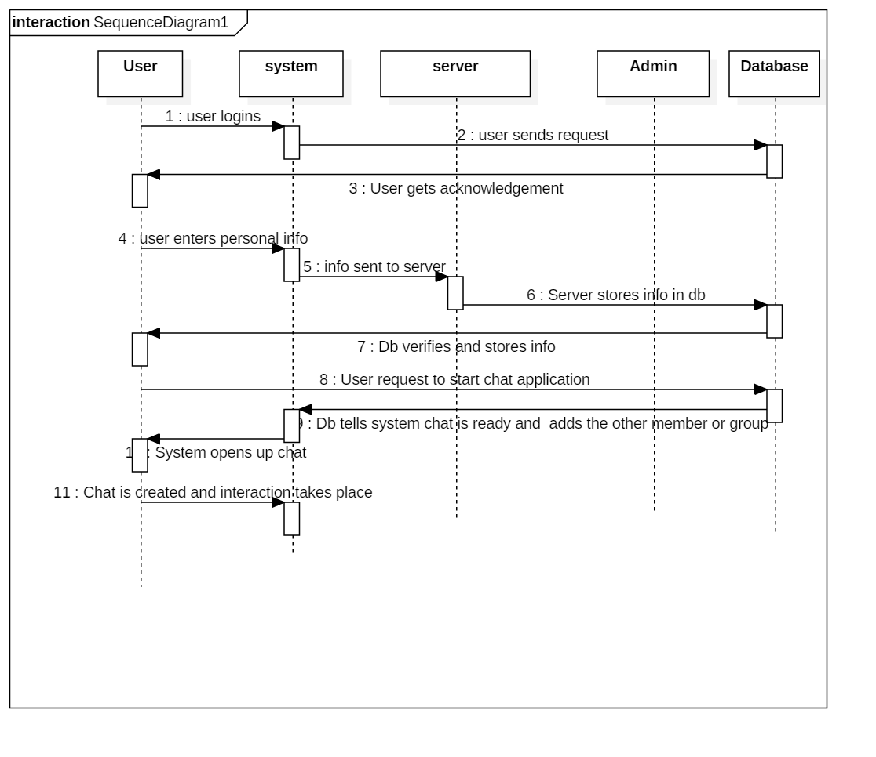
THE SEQUENCE DIAGRAM

Slide 23
HOW DOES OUR WEB-APPLICATION WORK?
CLIENT (FRONT-END)
APPLICATION SERVER
Database Connectivity

Slide 24
TECHNOLOGIES & TOOLS
FRONTEND - Java server pages
BACKEND- Mysql
JAVA- Eclipse
APACHE TOMCAT SERVER

Slide 25
THANK YOU!
QUESTIONS???

